Slide 1
Scheduling Heterogeneous Multi-Cores through Performance Impact Estimation (PIE)
Kenzo Van Craeynest,
Lieven Eeckhout
Aamer Jaleel,
Paolo Narvaez,
Joel Emer
ISCA 2012 presentation - June 11th 2012
Notes:
MI

Slide 2
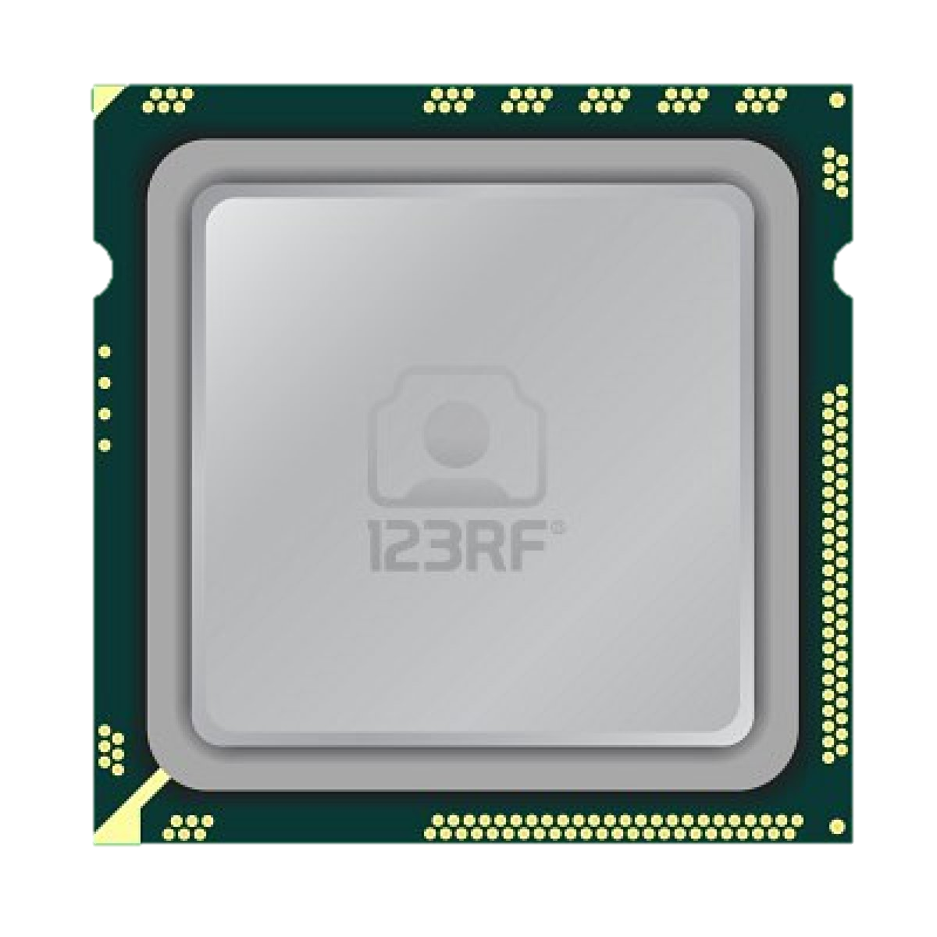
Single-ISA heterogeneous multi-cores
Multiple core types
representing different power/performance trade-offs
Well-established power benefits [Kumar et al. MICRO’03, ISCA’04]
Big.LITTLE and Kal-El
big high-performance cores
B
B
B
…
small power-efficient cores
S
S
S
S
…
6/11/2012
2

Slide 3
The effectiveness of heterogeneous multi-cores depends on workload-to-core mapping
throughput
flexible
big high-performance cores
Application threads
B
B
B
power
…
?
small power-efficient cores
EDP
S
S
S
S
…
fairness
scalable
energy
6/11/2012
3

Slide 4
Envisioning a scalable, flexible and multi-objective scheduling algorithm
optimization criteria
estimated performance on small core
B
scheduler
S
estimated performance on big core
workload-to-core mapping
6/11/2012
4

Slide 5
Commonly used scheduling practice
Profiling
Sampling
Significant part of prior art uses idea:
memory-intensive applications mostly wait for memory
schedule on small core
small performance decrease
big power savings
memory-dominance scheduling
compute
waiting for memory
time
schedule on small core
longer execution time
6/11/2012
5
Notes:
A significant part of prior art uses this insight to base scheduling decision on.

Slide 6
Observation: Memory-intensive applications should not always be scheduled on the small core
Small-core slowdown can be big or small for both memory-intensive and compute-intensive applications
Kenzo Van Craeynest
6/11/2012
6

Slide 7
Need to account for MLP in memory-intensive applications
out-of-order execution
compute
issue loads
core stalls: waiting for memory
time
intuition
in-order execution:
MLP preserved
in-order execution: MLP not preserved
time
time
Kenzo Van Craeynest
6/11/2012
7
Notes:
Make title shorter, but say the same thing
Add graph from last slide with arrows

Slide 8
What about compute-intensive applications?
Both MLP and ILP are contributing factors for the small-core slowdown
Kenzo Van Craeynest
6/11/2012
8
Notes:
Unlike prior art that looks at memory-intensity alone, we do take into account cpi_base. This graph shows that this is very important

Slide 9
Performance Impact Estimation (PIE)
estimating performance if the workload were to run on a different core type
CPI_{big}
MLP_{big}
ILP_{big}
CPI_{small}
B
CPI_{big}
S
CPI_{small}
MLP_{small}
ILP_{small}
6/11/2012
9

Slide 10
Performance Impact Estimation (PIE)
Determine where application spends its execution time
CPI_{big}
MLP_{big}
ILP_{big}
CPI_{small}
B
CPI_{big}
S
CPI_{small}
MLP_{small}
ILP_{small}
6/11/2012
10
Notes:
Color code the ILP and MLP

Slide 11
Performance Impact Estimation (PIE)
Determine where application spends its execution time
Use change in MLP exposed to predict change in CPI_{mem}
Use change in ILP exposed to predict change in CPI_{base}
CPI_{big}
MLP_{big}
ILP_{big}
CPI_{small}
B
MLP change
CPI_{big}
S
CPI_{small}
MLP_{small}
ILP_{small}
ILP change
6/11/2012
11
Notes:
Color code the ILP and MLP

Slide 12
Formal representation of the PIE Model
$$CPI = {CPI}_{base}+{CPI}_{mem}$$
Estimate big core performance while running on small core
$$\begin{matrix}{\tilde{CPI}}_{big} & = & {\tilde{CPI}}_{base,big}+{\tilde{CPI}}_{mem,big} \\ & = & {\tilde{CPI}}_{base,big}+{CPI}_{mem,small}×\frac{{MLP}_{small}}{{\tilde{MLP}}_{big}}\end{matrix}$$
Estimate small core performance while running on big core
$$\begin{matrix}{\tilde{CPI}}_{small} & = & {\tilde{CPI}}_{base,small}+{\tilde{CPI}}_{mem,small} \\ & = & {\tilde{CPI}}_{base,small}+{CPI}_{mem,big}×\frac{{MLP}_{big}}{{\tilde{MLP}}_{small}}\end{matrix}$$
predict
6/11/2012
12

Slide 13
Running on small, predicting CPI_{base,big}
A balanced big (out-of-order) core should be able to dispatch approximately issue_width (W_{big}) instructions per cycle in the absence of miss events.
$$\begin{matrix}{\tilde{CPI}}_{base,big} & = & \frac{1}{W_{big}} \\ & & \end{matrix}$$
CPI
small core
predicted big core
Kenzo Van Craeynest
6/11/2012
13

Slide 14
Running on small, predicting MLP_{big}
$$\begin{matrix} & & \\ {\tilde{CPI}}_{mem,big} & = & {CPI}_{mem,small}×\frac{{MLP}_{small}}{{\tilde{MLP}}_{big}}\end{matrix}$$
CPI
Out-of-order execution:
head
small core
predicted big core
ROB:
mem | x | x | x | mem | … | mem | x
ROB size
Prob[ insn is a memory access ] = misses_per_instruction
MLP_{big} = average number of memory accesses in the ROB
= misses_per_instruction * ROB_size
Kenzo Van Craeynest
6/11/2012
14

Slide 15
Formal representation of the PIE Model
$$CPI = {CPI}_{base}+{CPI}_{mem}$$
Estimate big core performance while running on small core
$$\begin{matrix}{\tilde{CPI}}_{big} & = & {\tilde{CPI}}_{base,big}+{\tilde{CPI}}_{mem,big} \\ & = & {\tilde{CPI}}_{base,big}+{CPI}_{mem,small}×\frac{{MLP}_{small}}{{\tilde{MLP}}_{big}}\end{matrix}$$
Estimate small core performance while running on big core
$$\begin{matrix}{\tilde{CPI}}_{small} & = & {\tilde{CPI}}_{base,small}+{\tilde{CPI}}_{mem,small} \\ & = & {\tilde{CPI}}_{base,small}+{CPI}_{mem,big}×\frac{{MLP}_{big}}{{\tilde{MLP}}_{small}}\end{matrix}$$
6/11/2012
15

Slide 16
Running on big, predicting CPI_{base,small}
We use a model based on the probability that x instructions will execute
Example: Prob[executing two instructions per cycle] ?
CPI
big core
predicted small core
insn 3 must depend on insn 1 or insn 2
= dependency distance is <= 2
1 | 2 | 3 | 4
insn 2 cannot depend on insn 1
= dependency distance is > 1
*Small core = 4-wide in-order
Kenzo Van Craeynest
6/11/2012
16

Slide 17
Running on big, predicting MLP_{small}
$$\begin{matrix} & & \\ {\tilde{CPI}}_{mem,small} & = & {CPI}_{mem,big}×\frac{{MLP}_{big}}{{\tilde{MLP}}_{small}}\end{matrix}$$
CPI
In-order execution (stall on use):
producer
predicted small core
big core
mem | 1 | 2 | 3 | … | … | … | x
consumer
independent instructions
dependency distance (D)
$\tilde{MLP}$_{small} = average number of memory accesses in the ‘instruction window’
= misses_per_instruction * D_{average}
Kenzo Van Craeynest
6/11/2012
17

Slide 18
Inputs for PIE model
Need hardware counters for
per-thread cache misses
memory stall cycles
Profile information for which PIE needs additional support
recording dependency distance distribution: 5 counters
tracking dependencies: 4 bits per architectural register
roughly 15-20 bytes of storage per core
6/11/2012
18

Slide 19
Using PIE to determine a static schedule
1 in-order core / 1 out-of-order core
Private last-level cache
Selection of scheduling-sensitive workload mixes
84%
Kenzo Van Craeynest
6/11/2012
19
Notes:
Use bar charts instead

Slide 20
Evaluating dynamic PIE scheduling
1 in-order core / 1 out-of-order core
Migration period: 2.5ms
Private last-level caches
See paper for
alternative cache hierarchies
different core counts
different small-to-big core ratios
PIE outperforms memory-dominance scheduling by 5.5% and sampling-based scheduling by 8.7%
Kenzo Van Craeynest
6/11/2012
20

Slide 21
Evaluating dynamic PIE scheduling
See paper for
alternative cache hierarchies
different core counts
different small-to-big core ratios
1 in-order core / 1 out-of-order core
Migration period: 2.5ms
Shared last-level cache
5.5%
8.7%
Kenzo Van Craeynest
6/11/2012
21

Slide 22
Conclusions and contributions
Using memory intensity, MLP or ILP alone as an indicator to guide workload scheduling decisions is insufficient
CPI
MLP
CPI
MLP
ILP
ILP
big core
predicted small core
small core
predicted big core
Each core can individually estimate performance on the other core types
Kenzo Van Craeynest
6/11/2012
22

Slide 23
Conclusions and contributions
PIE is scalable with core count
Requires limited hardware to collect profile information at runtime
Evaluate PIE for a variety of systems with varying core counts and cache configurations
PIE improves system performance by an average of 5.5% over recent state-of-the-art scheduling proposals and by 8.7% over a sampling-based scheduling policy
Kenzo Van Craeynest
6/11/2012
23

Slide 24
Questions?
Kenzo Van Craeynest
6/11/2012
24

Slide 25
Dynamic Thread Migration: Sampling
Previous results encourage a sampling based approach
frequent migration doesn’t hurt performance (much)
Periodically force thread on each core type and measure performance difference
B
…
time
forced migration
forced migration
S
…
time
evaluation
evaluation

Slide 26
Dynamic Thread Migration: Sampling
Previous results encourage a sampling based aproach
frequent migration doesn’t hurt performance (much)
Periodically force thread on each core type and measure performance difference
doesn’t scale well: big core quickly becomes bottleneck
very few insight is gained: observation only
slower to adapt to phase changes
B
…
time
S
…
time
S
…
time

Slide 27
State of the art
Profile based [Chen and John]
needs offline information
Sampling based [Kumar et al., Becchi and Crowley]
does not scale well with increasing core (type) count
migration overhead
slow to adapt to phase changes
A proxy to predict relative performance
stall cycles
execution speed
cpu utilization
memory stall cycles
Biggest core first scheduling [Li at al.]
Maximize utilization of the big core
Kenzo Van Craeynest
6/11/2012
27

Slide 28
PIE accurately predicts the relative performance differences between the big and small cores
Estimate big(small)-core performance while executing the workload on a small (big) core
Average absolute prediction error of 9% and 13%
6/11/2012
28

Slide 29
Static scheduling using PIE
Heterogeneous (1 big,1 small) multi-core
e.g., ARM’s big.LITTLE
PIE to determine the workload-to-core mapping
Memory-dominance scheduling:
always scheduling memory-intensive workloads on the small core.
6/11/2012
29

Slide 30
Static scheduling using PIE
4 core heterogeneous multi-core
e.g., NVidia’s Kal-El
PIE to determine the workload-to-core mapping
Memory-dominance scheduling:
always scheduling memory-intensive workloads on the small core.
6/11/2012
30

Slide 31
Performance impact varies across applications
Simulation based study
small
big
relative performance
Scheduling for heterogeneous multi-cores is a significant problem
6/11/2012
31

Slide 32
Both ILP and MLP are important for scheduling
compute-bound
memory-bound

Slide 33
Quantifying migration overhead
1 application, 2 identical cores
Migrate application every x ms
Shared last-level cache (4MB)
Kenzo Van Craeynest, VSSAD intern
6/11/2012
Kenzo Van Craeynest
6/11/2012
33

Slide 34
Caveat: high performance degradation if data not preserved in LLC
1 application, 2 identical cores
Migrate application every x ms
Private last-level cache (4MB), LLC powered off
Kenzo Van Craeynest
6/11/2012
34

