Slide 1
High Performing Cache Hierarchies for Server Workloads
Aamer Jaleel*, Joseph Nuzman, Adrian Moga,
Simon Steely Jr., Joel Emer*
Intel Corporation, VSSAD
( *Now at NVIDIA )
International Symposium on High Performance Computer Architecture (HPCA-2015)
Notes:
Thank you for the introduction. Good morning. This work was done while I was at the VSSAD research group at Intel.
In this talk I will show that the existing strategy of using the same core for client and server processors results in the same type of cache hierarchies for client and server workloads. However, such a strategy leaves performance on the table for commercial server workloads. This talk presents an overview of a high performing cache hierarchy that performs well for both client and server workloads.

Slide 2
Motivation
  Factors making caching important
    CPU speed >> Memory speed
    Chip Multi-Processors (CMPs)
  Variety of Workload Segments:
    Multimedia, games, workstation, commercial server, HPC, …
  High Performing Cache Hierarchy:
    Reduce main memory accesses ( e.g. RRIP replacement policy )
    Service on-chip cache hits with low latency
iL1
dL1
iL1
dL1
iL1
dL1
L2
L2
L2
LLC
Bank
LLC
Bank
LLC
Bank
Notes:
A mature field such as caching still has significant importance today! This is because the memory speeds continue to lag behind processor speeds. Additionally, the multi-core era coupled by the wide variety of workload segments poses significant challenges on designing better cache hierarchies.
In general, a high performing cache hierarchy has two properties. First, it reduces accesses to main memory. Our group has done on designing high performing low overhead replacement policies such as RRIP that are implemented in Intel processors today.
Second, a high performing cache hierarchy must service on-chip cache hits with low latency. Unfortunately, while our existing strategy does a good job at reducing accesses to memory, it is unable to provide low on-chip hit latency, especially for commercial workloads.

Slide 3
LLC Hits SLOW in Conventional CMPs
Typical Xeon Hierarchy
CORE 0
CORE 1
CORE 2
CORE3
CORE ‘n’
32KB L1
32KB L1
32KB L1
32KB L1
32KB L1
+ 3 cycs
256KB L2
256KB L2
256KB L2
256KB L2
256KB L2
+ 10 cycs
INTERCONNECT
+ 10 cycs
2MB L3 “slice”
2MB L3 “slice”
2MB L3 “slice”
2MB L3 “slice”
2MB L3 “slice”
+ 14 cycs
  Large on-chip shared LLC ➔ more application working-set resides on-chip
  LLC access latency increases due to interconnect ➔ LLC hits become slow
L2 Hit Latency: ~15 cycles LLC Hit Latency: ~40 cycles
Notes:
To illustrate this problem, let me first provide with you a background on the existing Xeon multi-core three-level cache hierarchy. A typical Xeon core consists of 32KB L1 I/D caches and a 256KB L2 cache and a 2MB L3 bank attached to it. A CMP consists of many cores and L3 banks. The L3 cache is typically shared by all cores on-chip. This enables a gigantic LLC that allows more of the application working set to reside on chip.
Since the LLC is shared, an interconnect path is needed to access the appropriate slice. The consequence however is that the LLC access latency increases, and LLC hits become slow.
To give you an idea, the individual latencies are provided on the right. As can be seen, the interconnect and LLC bank access latency amounts to more than 50% of the LLC hit latency

Slide 4
Performance Characterization of Workloads
Prefetching OFF
Prefetching ON
10-30%
15-40%
Single-Thread Simulated on 16-core CMP
Server Workloads Spend Significant Execution Time Waiting on L3 Cache Access Latency ☹

Slide 5
Performance Inefficiencies in Existing Cache Hierarchy
  Problem: L2 cache ineffective when the frequently referenced application working set is larger than L2 (but fits in LLC)
  Solution: Increase L2 Cache Size
iL1
dL1
iL1
dL1
iL1
dL1
iL1
dL1
L2
L2
L2
L2
NOT SCALABLE
SCALABLE
LLC
LLC
LLC
LLC
LLC
Must also increase LLC size for
an inclusive cache hierarchy
Redistribute cache resources
Requires reorganizing hierarchy

Slide 6



Cache Organization Studies
iL1
dL1
iL1
dL1
iL1
dL1
256KB L2
512KB L2
OR
1MB L2
2MB LLC
1.5 MB LLC
1MB LLC
(Inclusive LLC)
(Exclusive LLC)
(Exclusive LLC)
  Increase L2 cache size while reducing LLC ➔ Design exclusive cache hierarchy
    Exclusive hierarchy helps retain existing on-chip caching capacity ( i.e. 2MB / core )
    Exclusive hierarchy enables better average cache access latency
    Access latency overhead for larger L2 cache is minimal (+0 for 512KB, +1 cycle for 1MB)

Slide 7
Performance Sensitivity to L2 Cache Size
Server Workloads Observe the MOST Benefit from Increasing L2 Cache Size

Slide 8
Server Workload Performance Sensitivity to L2 Cache Size
A Number of Server Workloads Observe > 5% benefit from larger L2 caches
Where Is This Performance Coming From????

Slide 9
Understanding Reasons for Performance Upside
  Larger L2 ➔ Lower L2 miss rate ➔ More requests serviced at L2 hit latency
  Two types of requests: Code Requests and Data Requests
    Which requests serviced at L2 latency provide bulk of performance?
  Sensitivity Study: In baseline inclusive hierarchy (256KB L2), evaluate:
    i-Ideal: L3 code hits always serviced at L2 hit latency
    d-Ideal: L3 data hits always serviced at L2 hit latency
    id-Ideal: L3 code and data hits always serviced at L2 hit latency
    NOTE: This is NOT a perfect L2 study.
Notes:
This study still fills code and data into the L2. The sensitivity study also takes into account latency due to misses to memory. The study measures latency sensitivity for only those requests that hit in the L3.

Slide 10
Code/Data Request Sensitivity to Latency
256KB L2 /2MB L3 (Inclusive)
sensitive to data
sensitive to code
Performance of Larger L2 Primarily From Servicing Code Requests at L2 Hit Latency
(Shouldn’t Be Surprising – Server Workloads Generally Have Large Code Footprints)

Slide 11
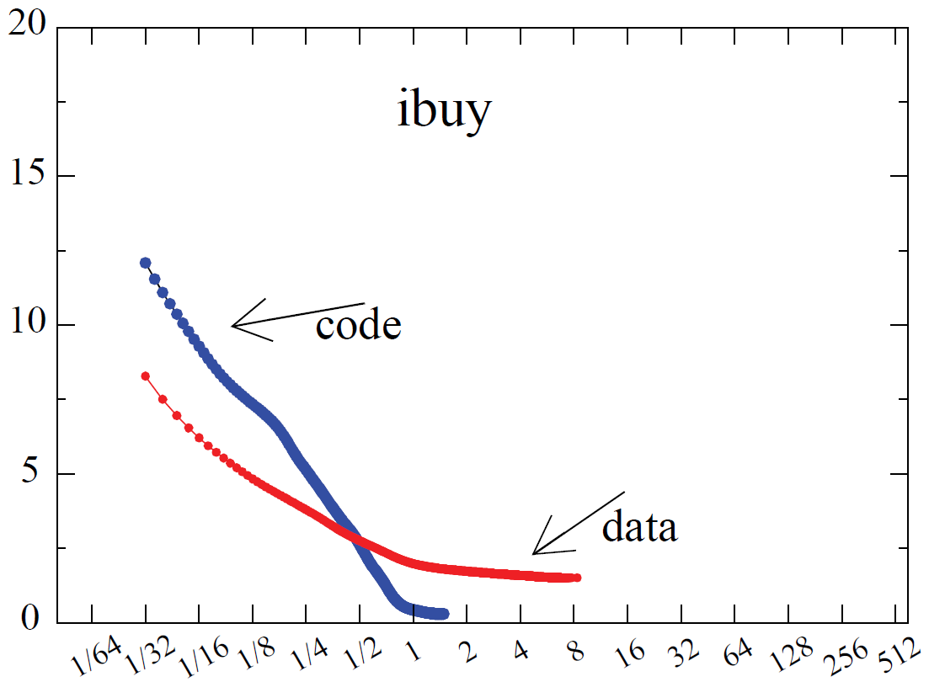
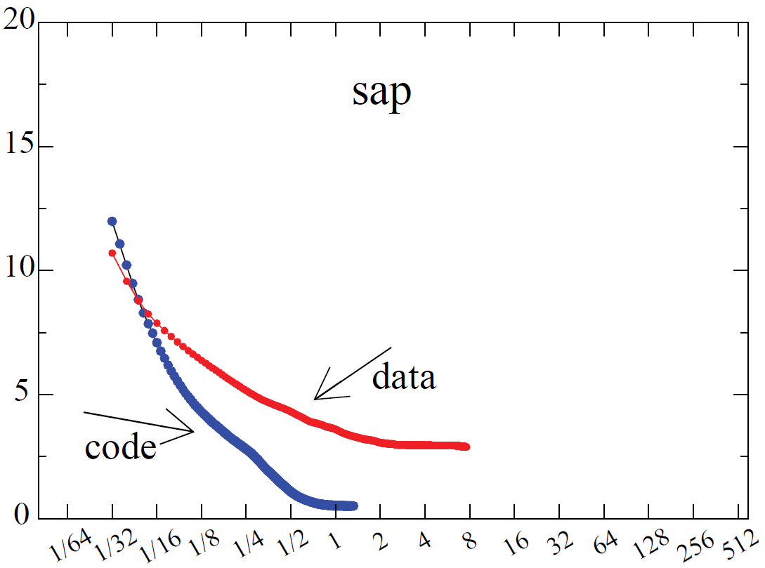
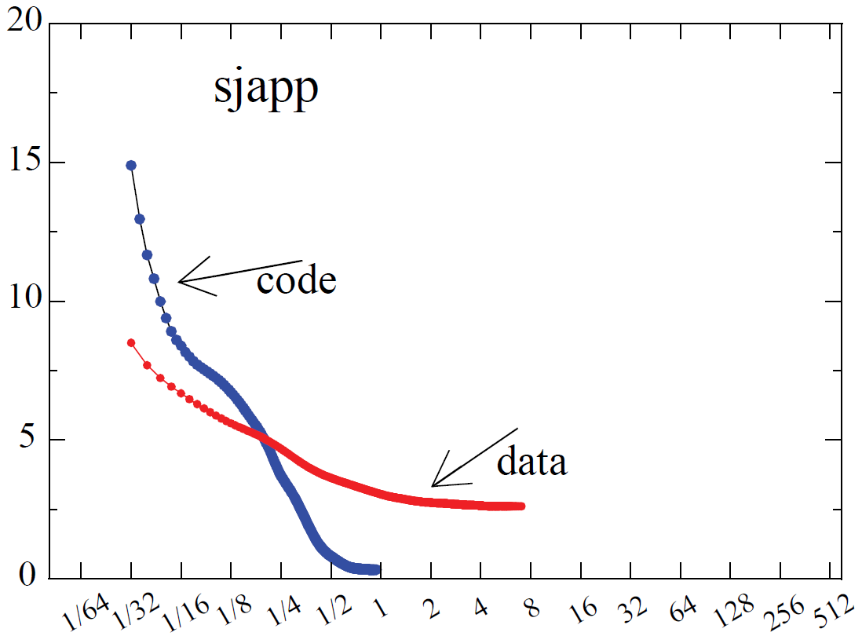
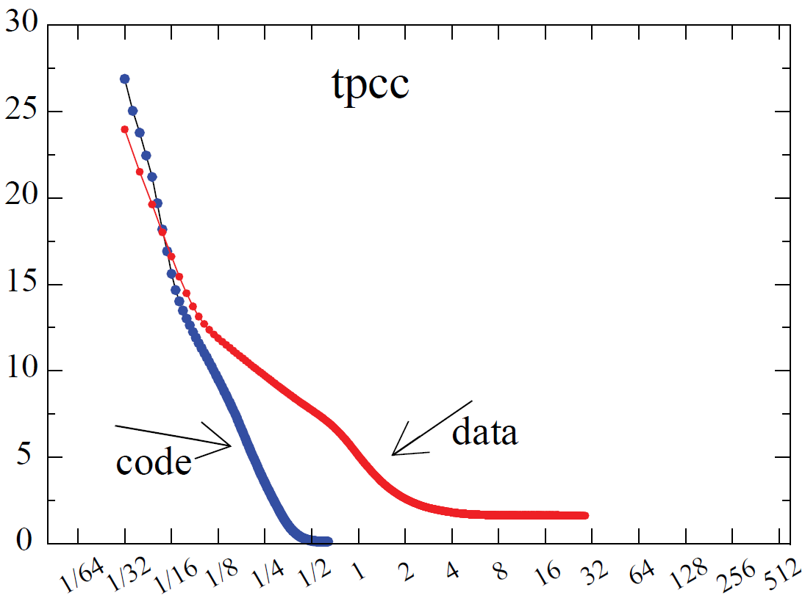
SERVER
LARGE
CODE
WORKING
SET
(0.5MB – 1MB)
MPKI
MPKI
Cache Size (MB)
Cache Size (MB)
MPKI
MPKI
Cache Size (MB)
Cache Size (MB)

Slide 12
Enhancing L2 Cache Performance for Server Workloads
  Observation: Server workloads require servicing code requests at low latency
    Avoid processor front-end from frequent “hiccups” to feed the processor back-end
    How about prioritize code lines in the L2 cache using the RRIP replacement policy
  Proposal: Code Line Preservation (CLIP) in L2 Caches
    Modify L2 cache replacement policy to preserve more code lines over data lines
code inserts
inserts
data inserts
0
Imme-
diate
1
Inter-
mediate
2
far
3
distant
eviction
No Victim
No Victim
No Victim
re-reference
data re-reference
data re-reference
data re-reference
re-reference
re-reference

Slide 13
Performance of Code Line Preservation (CLIP)
CLIP similar
to doubling L2 cache
Still Recommend Larger L2 Cache Size and Exclusive Cache Hierarchy for Server Workloads

Slide 14
Tradeoffs of Increasing L2 Size and Exclusive Hierarchy
  Functionally breaks recent replacement policies (e.g. RRIP)
    Solution: save re-reference information in L2 (see paper for details)

Slide 15
Call For Action: Open Problems in Exclusive Hierarchies
  Functionally breaks recent replacement policies (e.g. RRIP)
    Solution: save re-reference information in L2 (see paper for details)
  Effective caching capacity of the cache hierarchy reduces
iL1
dL1
iL1
dL1
iL1
dL1
iL1
dL1
iL1
dL1
iL1
dL1
iL1
dL1
iL1
dL1
256KB L2
256KB L2
256KB L2
256KB L2
1MB L2
1MB L2
1MB L2
1MB L2
2MB
2MB
2MB
2MB
1MB
1MB
1MB
1MB

Slide 16
Call For Action: Open Problems in Exclusive Hierarchies
  Functionally breaks recent replacement policies (e.g. RRIP)
    Solution: save re-reference information in L2 (see paper for details)
  Effective caching capacity of the cache hierarchy reduces
iL1
dL1
iL1
dL1
iL1
dL1
iL1
dL1
iL1
dL1
iL1
dL1
iL1
dL1
iL1
dL1
iL1
dL1
iL1
dL1
iL1
dL1
iL1
dL1
iL1
dL1
iL1
dL1
iL1
dL1
iL1
dL1
1MB L2
1MB L2
1MB L2
1MB L2
256KB L2
256KB L2
256KB L2
256KB L2
1MB L2
1MB L2
1MB L2
1MB L2
256KB L2
256KB L2
256KB L2
256KB L2
1MB
1MB
1MB
1MB
4MB
2MB
2MB
2MB
2MB
1MB
1MB
8MB
2MB
2MB
2MB

Slide 17

Call For Action: Open Problems in Exclusive Hierarchies
  Functionally breaks recent replacement policies (e.g. RRIP)
    Solution: save re-reference information in L2 (see paper for details)
  Effective caching capacity of the cache hierarchy reduces
IDLE
iL1
iL1
iL1
iL1
dL1
dL1
dL1
IDLE
iL1
dL1
iL1
dL1
iL1
dL1
iL1
dL1
dL1
IDLE
IDLE
256KB L2
256KB L2
256KB L2
256KB L2
1MB L2
1MB L2
1MB L2
1MB L2
4MB
8MB
1MB
1MB
2MB
2MB
2MB
  Idle Cores ➔ Waste of Private L2 Cache Resources
  e.g. two cores active with combined working set size greater than 4MB but less than 8MB
Private Large L2 Caches Unusable by Active Cores When CMP is Under-subscribed
Revisit Existing Mechanisms on Private/Shared Cache Capacity Management

Slide 18
Call For Action: Open Problems in Exclusive Hierarchies
  Functionally breaks recent replacement policies (e.g. RRIP)
    Solution: save re-reference information in L2 (see paper for details)
  Effective caching capacity of the cache hierarchy reduces
iL1
dL1
iL1
dL1
iL1
dL1
iL1
dL1
256KB L2
256KB L2
256KB L2
256KB L2
8MB
2MB
2MB
2MB
  Large Shared Data Working Set ➔ Effective Hierarchy Capacity Reduces
Shared Data Replication in L2 caches Reduces Hierarchy Capacity

Slide 19
Call For Action: Open Problems in Exclusive Hierarchies
  Functionally breaks recent replacement policies (e.g. RRIP)
    Solution: save re-reference information in L2 (see paper for details)
  Effective caching capacity of the cache hierarchy reduces
iL1
dL1
iL1
dL1
iL1
dL1
iL1
dL1
iL1
dL1
iL1
dL1
iL1
dL1
iL1
dL1
256KB L2
256KB L2
256KB L2
256KB L2
1MB L2
1MB L2
1MB L2
1MB L2
4MB
8MB
1MB
1MB
2MB
2MB
2MB
  Large Shared Data Working Set ➔ Effective Hierarchy Capacity Reduces
  e.g. 0.5MB shared data, exclusive hierarchy capacity reduces by ~25% (0.5MB*5=2.25MB replication)
Shared Data Replication in L2 caches Reduces Hierarchy Capacity
Revisit Existing Mechanisms on Private/Shared Cache Data Replication

Slide 20
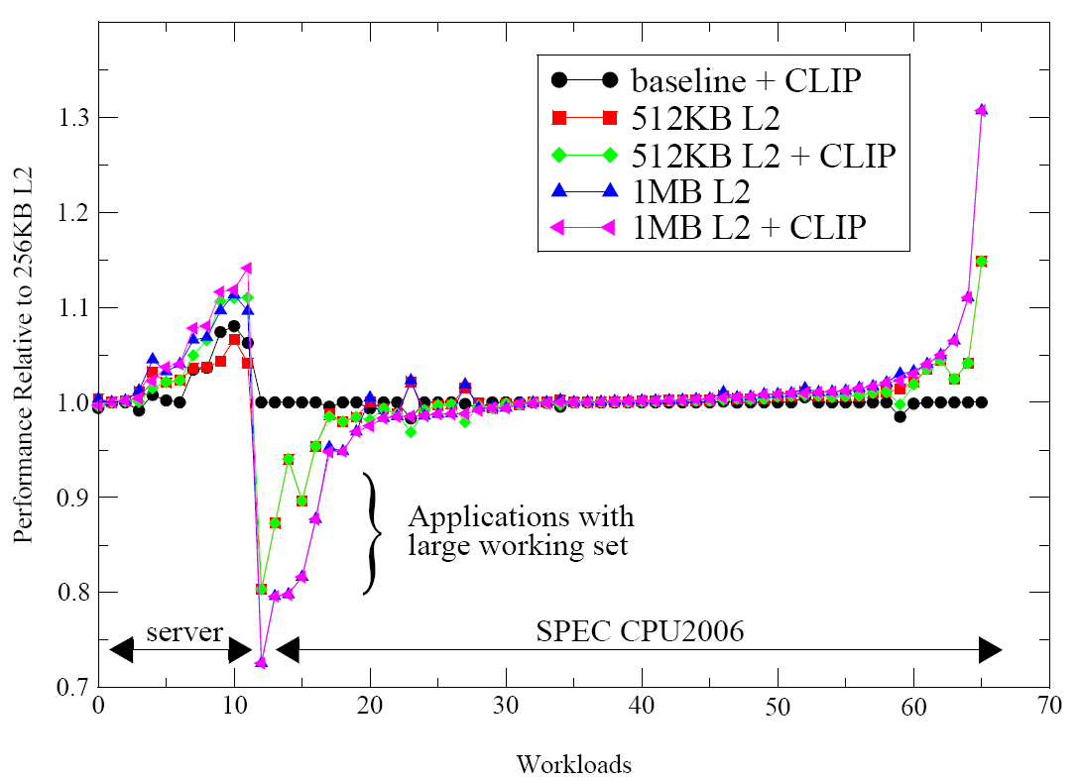
Multi-Core Performance of Exclusive Cache Hierarchy
16T-server 1T, 2T,4T, 8T, and 16T SPEC workloads
Call For Action: Develop Mechanisms to Recoup Performance Loss

Slide 21
Summary
  Problem: On-chip hit latency is a problem for server workloads
  We show: server workloads have large code footprints that need to be serviced out of L1/L2 (not L3)
  Proposal: Reorganize Cache Hierarchy to Improve Hit Latency
    Inclusive hierarchy with small L2 ➔ Exclusive hierarchy with large L2
    Exclusive hierarchy enables improving average cache access latency

Slide 22
Q&A

Slide 24
High Level CMP and Cache Hierarchy Overview
iL1
dL1
“core”
unified L2
L3 “slice”
“uncore”
“ring”
“mesh”
  CMP consists of several “nodes” connected via an on-chip network
    A typical “node” consists of a “core” and “uncore”
      “core” ➔ CPU, L1, and L2 cache
      “uncore” ➔ L3 cache slice, directory, etc.

Slide 25
Performance of Code Line Preservation (CLIP)
CLIP similar
to doubling L2 cache
On Average, CLIP Performs Similar to Doubling Size of the Baseline Cache
It is Still Better to Increase L2 Cache Size and Design Exclusive Cache Hierarchy

Slide 26
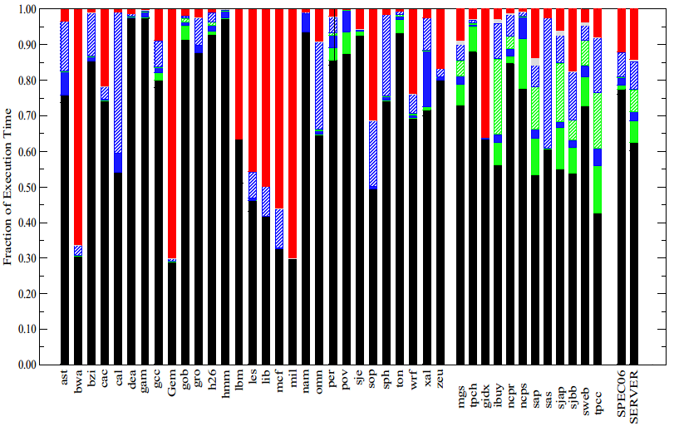
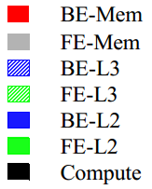
Performance Characterization of Workloads
Server Workloads Spend Significant Fraction of Time Waiting for LLC Latency

Slide 27
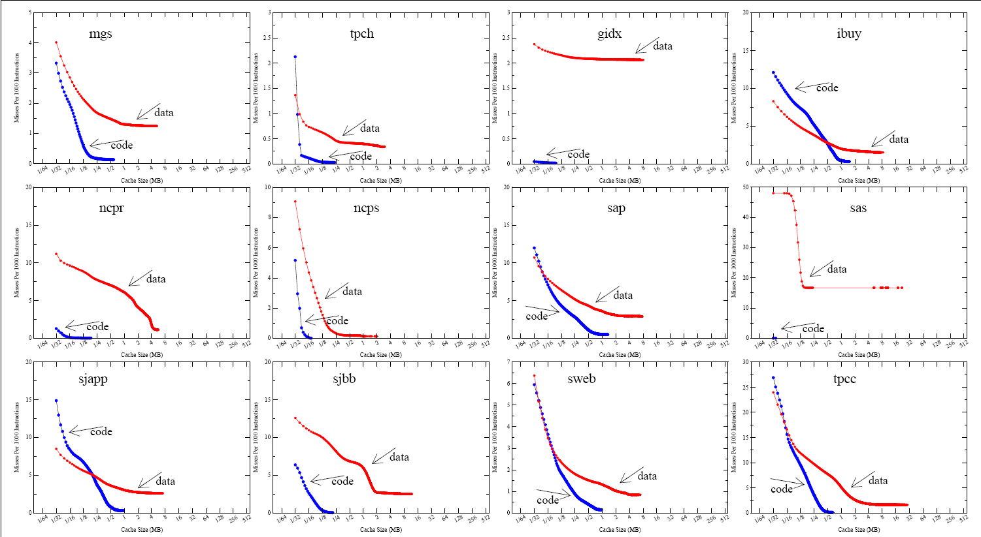

Slide 28
LLC Latency Problem with Conventional Hierarchy
  Fast Processor + Slow Memory ➔ Cache Hierarchy
  Multi-level Cache Hierarchy:
    L1 Cache: Designed for high bandwidth
    L2 Cache: Designed for latency
    L3 Cache: Designed for capacity
CORE
32KB L1
~ 4 cycs
256KB L2
~12 cycs
network
~10 cycs
2MB L3 “slice”
~40 cycs
Increasing Cores ➔ Longer Network Latency
➔ Longer LLC Access Latency ☹
DRAM
~200 cycs
Typical Xeon Hierarchy
*L3 Latency includes network latency
Notes:
Transition from MEM-CPI to LLC-CPI is missing

Slide 29
Performance Inefficiencies in Existing Cache Hierarchy
  Problem: L2 cache ineffective at hiding latency when the frequently referenced application working set is larger than L2 (but fits in LLC)
  Solution1: Hardware Prefetching
    Server workloads tend to be “prefetch unfriendly”
    State-of-the-art prefetching techniques for server workloads too complex
  Solution2: Increase L2 Cache Size
    Option 1: If inclusive hierarchy, must increase LLC size as well ☹
      Limited by how much on-chip die area can be devoted to cache space
    Option 2: Re-organize the existing cache hierarchy
      Decide how much area budget to spend on each cache level in the hierarchy
OUR FOCUS

Slide 30
Code/Data Request Sensitivity to Latency
256KB L2 /2MB L3 (Inclusive)
sensitive to data
sensitive to code
Performance of Larger L2 Primarily From Servicing Code Requests at L2 Hit Latency
(Shouldn’t Be Surprising – Server Workloads Generally Have Large Code Footprints)

Slide 31
Cache Hierarchy 101: Multi-level Basics
  Fast Processor + Slow Memory ➔ Cache Hierarchy
  Multi-level Cache Hierarchy:
    L1 Cache: Designed for bandwidth
    L2 Cache: Designed for latency
    L3 Cache: Designed for capacity
L1
L2
LLC
DRAM

Slide 32
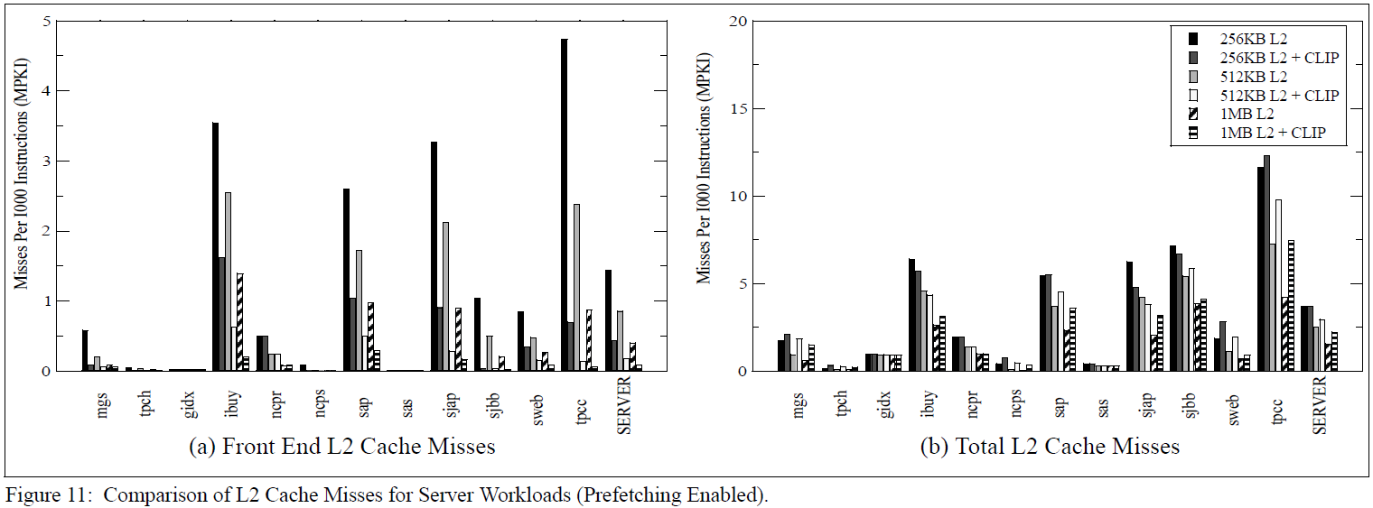
L2 Cache Misses

